Slide 1
Green University of Bangladesh
Department of Computer Science & Engineering
Subject: Data Electronic Devices and Circuits & Pulse Techniques
Course Code: EEE-203
My Presentation topic : About My Self
Submitted To:
Name : Md. Shariful Islam
Designation : Lecturer
Department : EEE
Green university of Bangladesh
Submitted by:
Name : Jakirul Islam
ID :193002101
Department : CSE

Slide 2
ABOUT ME
Hello Everyone.
My Name is Jakirul Islam.
I have Passed My HSC From Vashantack Govt college
At Present I am Studying At green university of Bangladesh In Computer Science & Engineering.
My home district is Jamalpur and I currently live in Dhaka

Slide 3
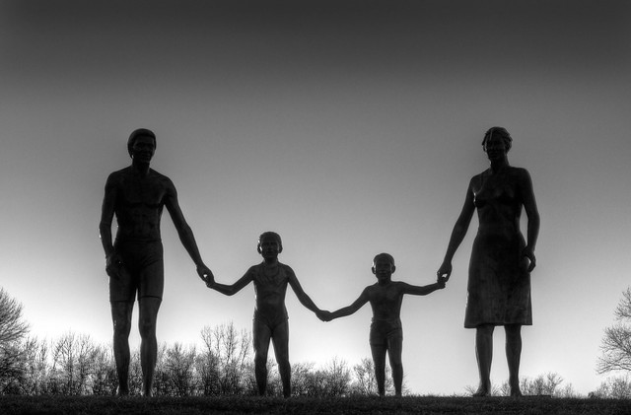
ABOUT MY FAMILY BACKGROUND
There are four members , In My Family , including me. My father , My mother And my one Sister.
My Father is Private service Holder
My Mother is a housewife
And My sister is a student.

Slide 4

MY HOBBIES AND INTEREST
I like To do creative things like Photoshop .
I like to spent my leisure time with my family and my friends .
And I like Listening music , watching TV , Net surfing and learning & I have Interest At learning Computer language.

Slide 5
ABOUT MY GOAL
My goal is to get a high position job in abroad and keep a business aside.
// My short term goal is to work in a good company where I want to enhance my knowledge and my skill and show my talent.
And my long term goal is get a very respected position.
// where I Make my parents to smile feel proud.

Slide 6
SKILL
Computer Programming language like C, C++ and JAVA
Good oral and Written Communication
Microsoft Word , Excel , PowerPoint

Slide 7
I HAVE SOME WEAK POINTS
I am bit lazy person and I can’t say no to anyone since I am very kind person.
AND MY STRONG POINTS
My strong sides are I am a Fast learner and I am also very self motivated With positive attitude towards my career.

Slide 8
THANK YOU

